Slide 1
Visualization of Fossil-Fuel CO2 Emissions Data
Qiulin Luo (luo.qiu@northeastern.edu)
Northeastern University

Slide 2
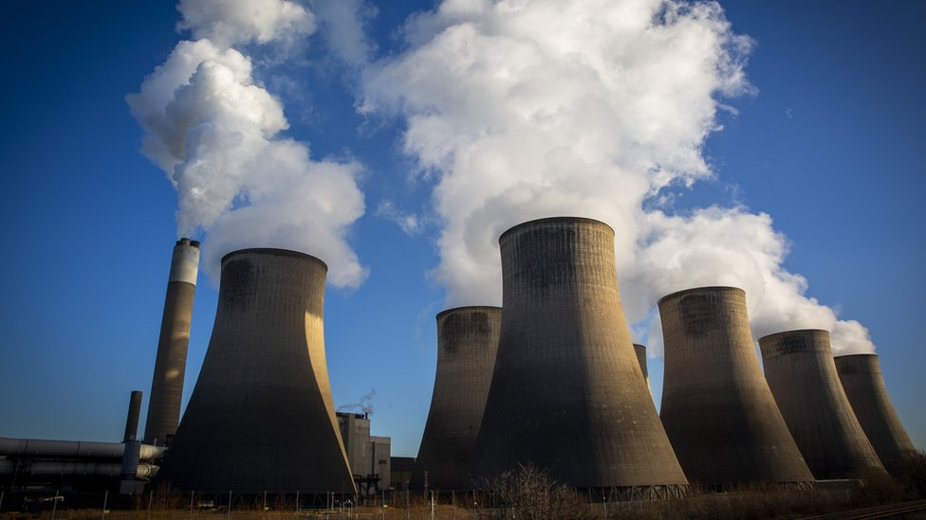
Motivation
Understand the scale of the problem
Identify patterns and trends
Compare and contrast
The increasing use of fossil fuels has led to a significant increase in carbon dioxide (CO2) emissions, which is a major contributor to climate change. To address this issue, I think it would be helpful to understand the patterns and trends of fossil-fuel CO2 emissions over time, across different countries and regions, and in different sectors. Data visualization is a powerful tool to communicate complex information and facilitate understanding of this issue.

Slide 3
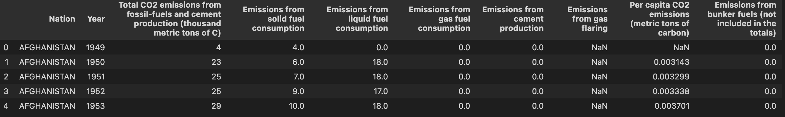
Dataset
(18547, 10)
Source: https://energy.appstate.edu/cdiac-appstate/data-products
Name: Global, Regional, and National Fossil-Fuel CO2 Emissions: 1751-2019
Feature: The dataset is a time series of Carbon Dioxide (CO2) emissions from
fossil-fuel combustion and cement manufacture.
The data from all countries are mixed together in the naked data, so data cleaning such as classification and grouping is needed.

Slide 4
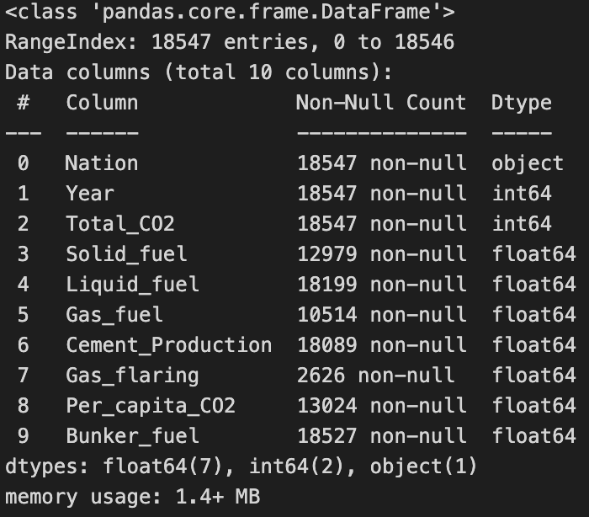
Dataset
We can see that for some of the columns there are null values. These values are for types of fuel causing the emission like solid fuel, liquid fuel, etc. As we have the Total_CO2, we can check with sum of all the emissions from fuel type available and the difference with total can be used to fill the NA available.
Unfortunately, futher go to the past, lesser the data for each country. We can check those countries and maybe understand from their vast historical, but for an overall perspective of the globe, it only makes sense to start from 1950 where we have data for 160 countries. Currently, for 2019 there is data for 222 countries.

Slide 5
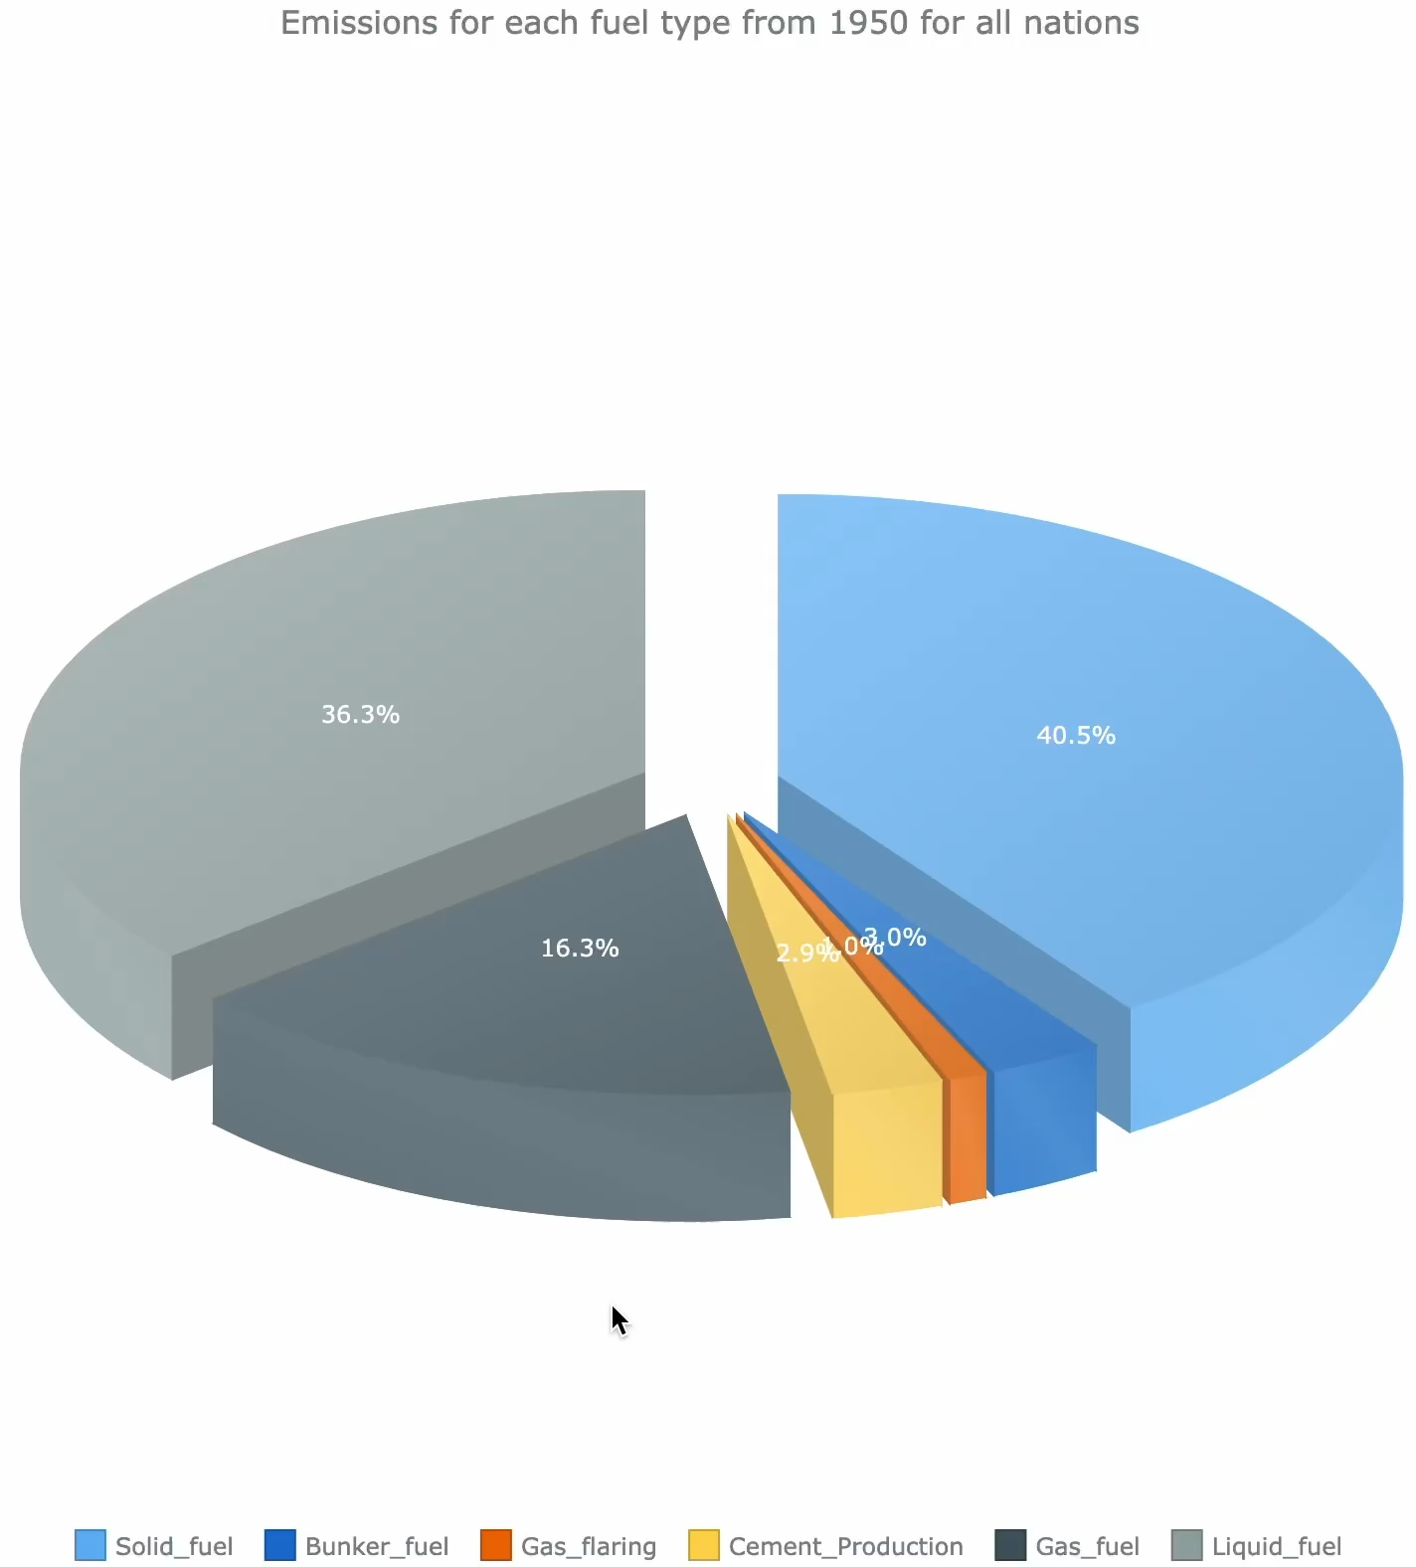
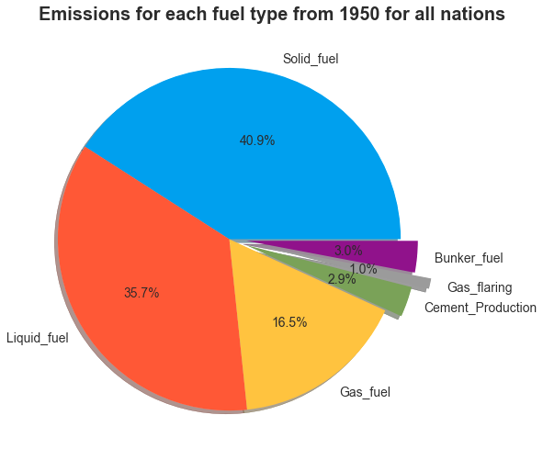
Visualization
Two 3-D pie charts were used to represent the percentage of each fossil fuel emission from 1950 onwards. The thickness of the static pie chart is just right to show that it is in 3d, different colors are used to represent
different fossil fuels, and the text legend is of the right size to not fill the pie chart and
make it look bad. Dynamic pie chart can be clicked to show detail information.

Slide 6
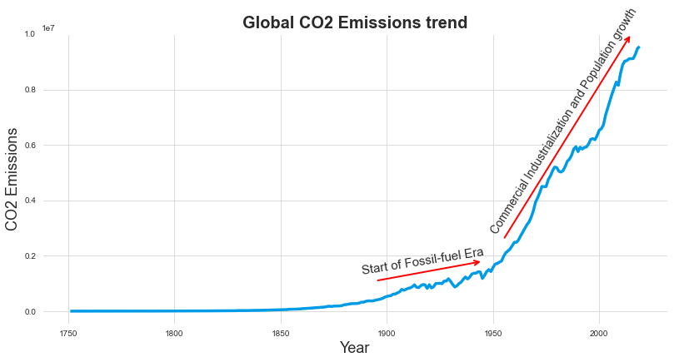
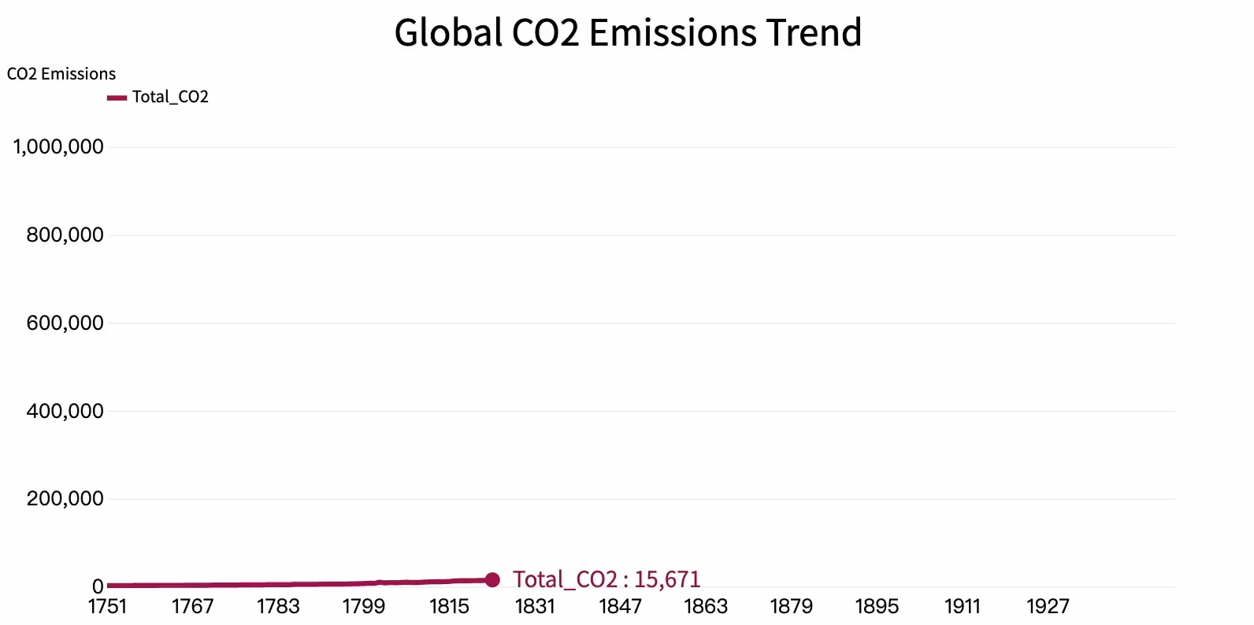
Visualization
The static figure uses a grid-based graph with red arrows placed at the ends of the curve with the greatest variation, along with text legends to illustrate the reason why fossil-fuel is dominant at a given stage.
The global CO2 emissions started to increase from 1900 and literally skyrocketed from 1950 and it doesn’t look like it is halting. The incredible increase from 1900 is mainly because of industrialization and population growth.

Slide 7
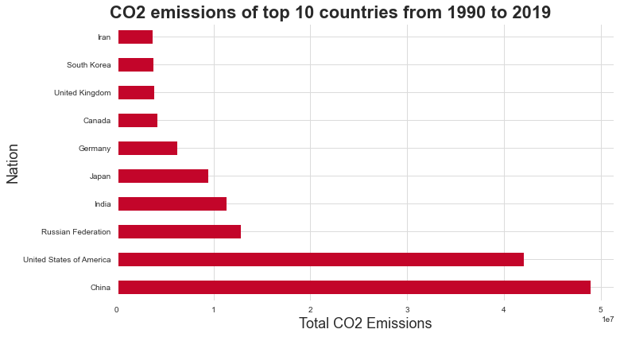
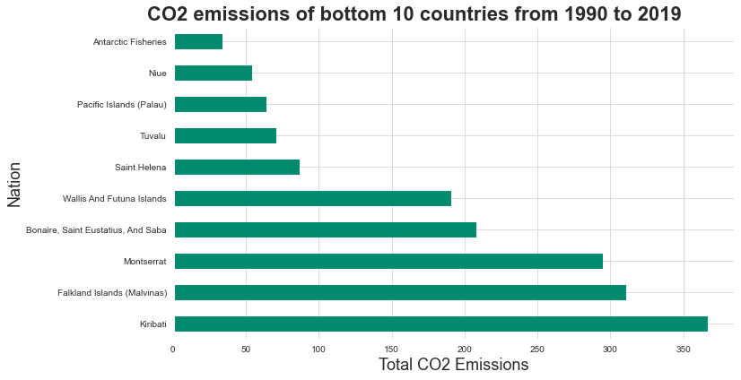
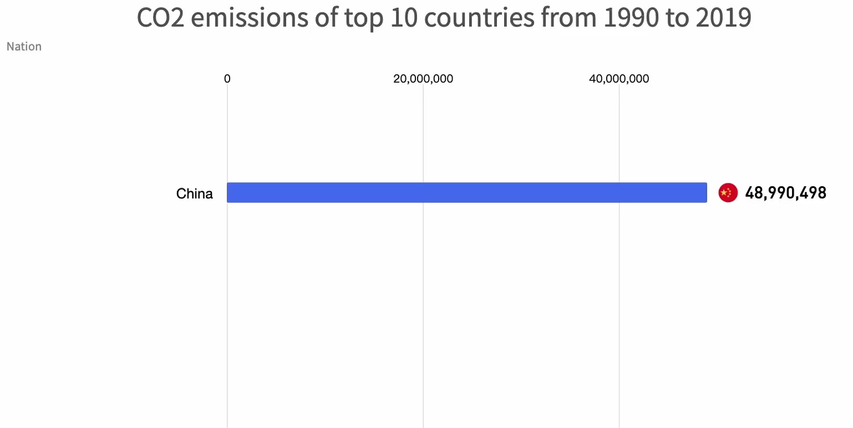
Visualization
Two separate vertical bars are used to represent the 10 countries with the largest and smallest total emissions since 1990 respectively, and since red and green colors represent an increase and a decrease respectively in common sense, the use of red and green contrast can enhance the perception.
The same sorting is used for both high and low to give a consistent look and feel.

Slide 8
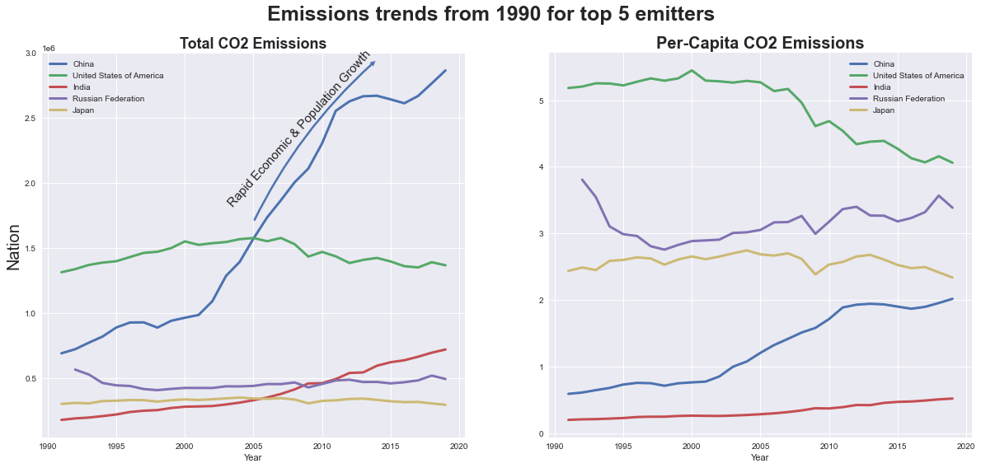
Visualization
Here, the left and right line graphs show the trend of annual net and annual average emissions over time for the five countries. The same method of labeling with text narrative is used to illustrate the special slopes.
We can see that US has been the leading emitter till 2005. They have stabilized their emissions in this century.Whereas for China, the emissions started to skyrocket from 2000. Japan and Russia also seem to have stabilized their emissions. The grid uses a square to make the growth and year interval ratio consistent and more harmonious in appearance.

Slide 9
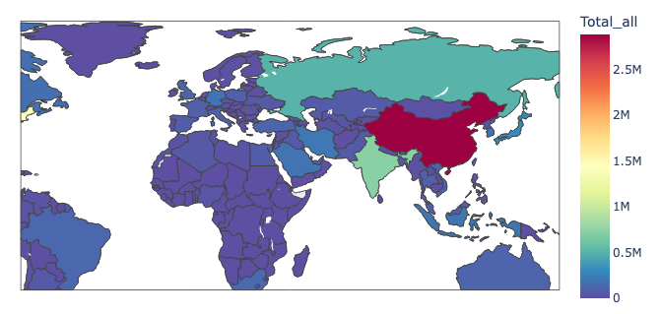
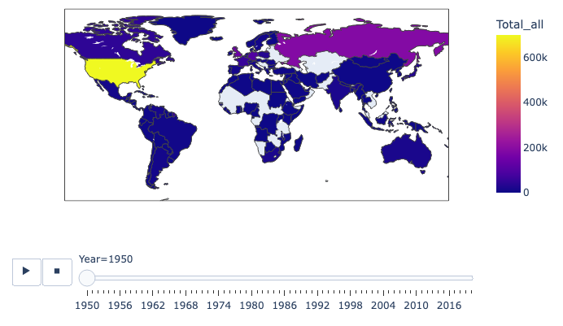
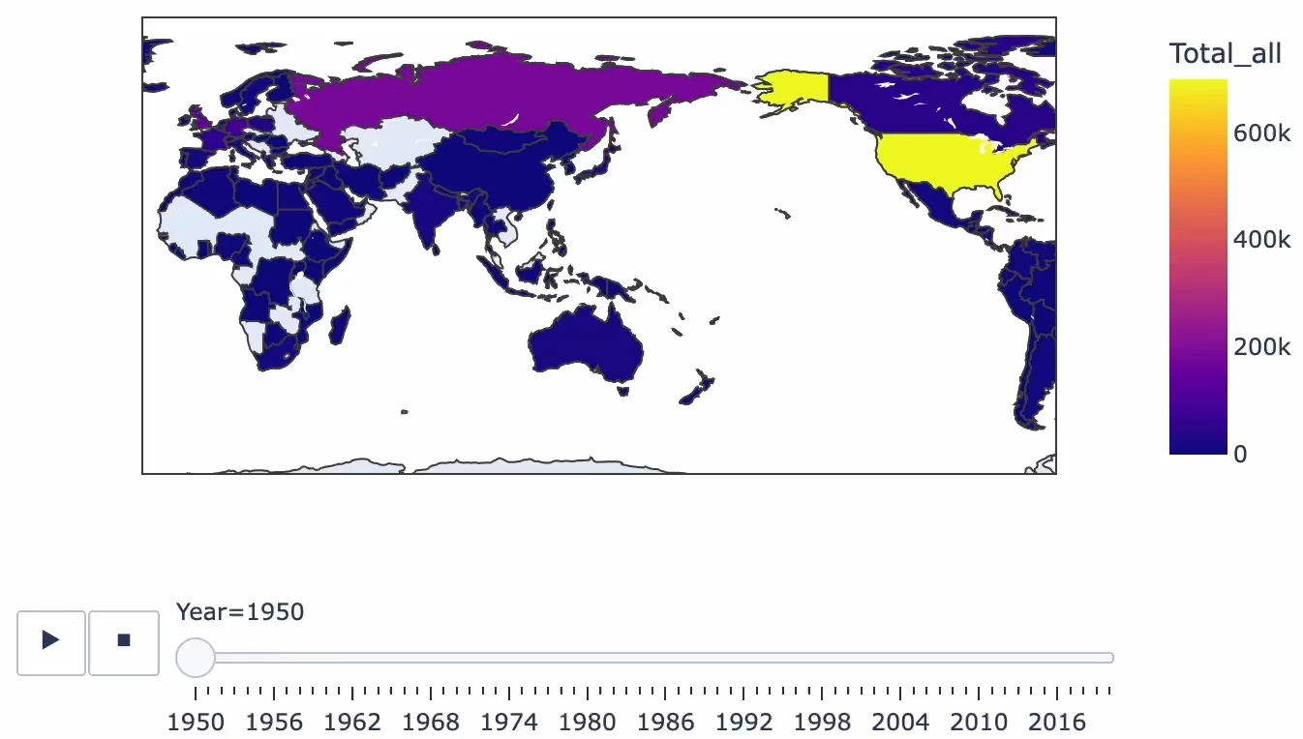
Visualization
The total amount of emissions and the percentage of choropleth are plotted separately, each of which can be viewed by freely dragging the map with the mouse. Thermodynamic color representation is used, and a timeline can be dragged at the bottom of the graph to observe the color changes.
The unit height and gradient color will be automatically increased when the current maximum emission exceeds the maximum value on the right. Clicking the play button the time bar will automatically start and each area will change color dynamically. Of course, the area where the mouse is located will show the exact emission value.

Slide 10
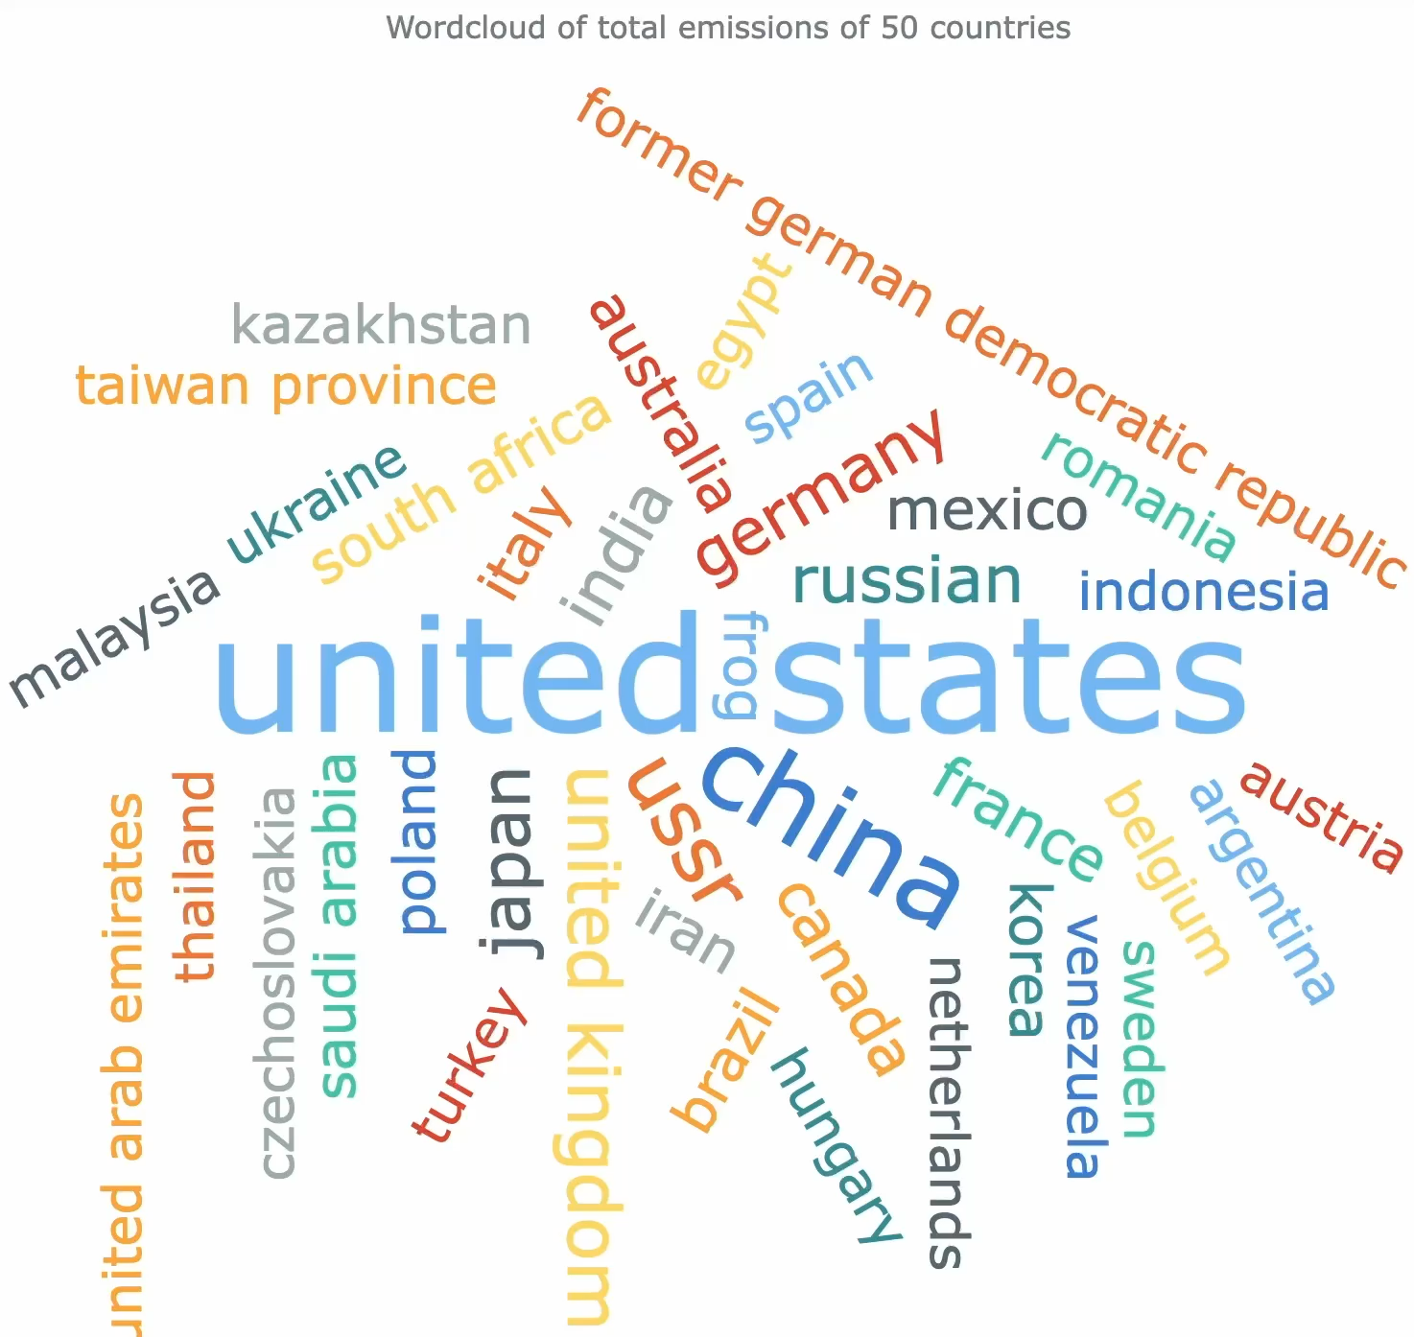
Visualization
The word cloud map is more suitable for readers who are sensitive to words and sentences.
The fontsize of each country name in the cloud is proportional to its emissions in the dataset, making it easy to see which words are the most important.

Slide 11
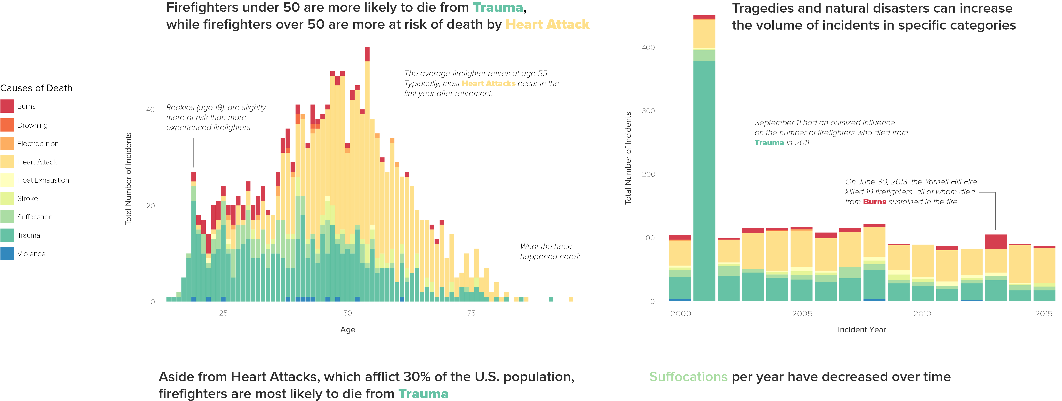
Future work
Machine learning or deep learning approaches to predict changes in fossil fuel emissions, such as LSTM and its improvements, can be considered.
There is still a lot of room for improvement in data visualization techniques, and more visualization papers and codes will be read and tried in the future.

Slide 12
Thank You!

